Slide 1
BPW-Ontario Membership Drive
A Spring Event for 2025

Slide 2
What We Want
Get Noticed:
We Exist! How to get the public to become interested in us? There is so much competing for people’s attention.
Short & Sweet:
We are all volunteers. Time is a precious resource.
We don’t want to ask too much of your time- just enough to have an impact!
Put Your Own Spin:
We recognize that each club has their own strength and culture.
We want you to attract those who value what you value. Feel free to customize!
Notes:
April 12th 1917 women gained the right to vote

Slide 3
Publicity Stunt
In marketing, a planned event designed to attract the public's attention to the event's organizers or their cause.
How?
Creativity to Capture Public Attention
Strategic Timing and Location:
Public Location &
Collective Participation
Coverage, let people know the event is coming:
Flyers on Community Boards, Library
Broadcast it through Social Media
Goal: Raise Awareness of us and our mission Women Working For Women

Slide 4
Tea & Triumph: A Pink Tea Party for Progress
A name that connects the historical context of the pink tea parties with the ongoing journey toward women’s empowerment. It also emphasizes the celebration of progress and the power of women coming together.
Interests
Awareness: Pink Tea Events Organized Every October
Educate: About the “Women are Persons” Ruling & how far we have come
Membership Drive: Let’s keep going; join us!
Dress Up & Make a Scene
All clubs of Ontario to devote 2 hours on April 12th (Saturday)
What time would be best?
Attention through dress: Sunday Best (pearls, gloves), Victorian (florals, hats), 1945 Rosie the Riveter(Bandanas) or other idea
Public Location
Mall
Outside a Shopping Center
Close to another event happening that Saturday
Notes:
Ontario became the fifth province to grant women the right to vote on 12 April 1917
The “Persons” Casecame about when five women’s rights activists in Alberta joined forces to challenge the interpretation of the British North America Act, the 1867 law that had created and governed the Dominion of Canada. The BNA Act stated that only “qualified persons” could be considered for a Senate position. Since only men had possessed legal rights in 1867, the phrase was interpreted as referring only to men; women were not considered “Persons” under the law.
The five activists later became known as the Famous Five: Emily Murphy, Irene Parlby, Nellie McClung, Louise McKinney, and Henrietta Muir Edwards. Each had worked in her own way to improve the lives of women and children.

Slide 5
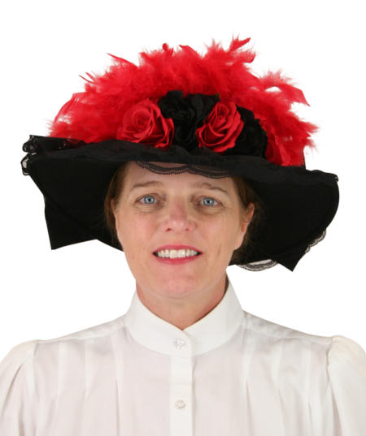
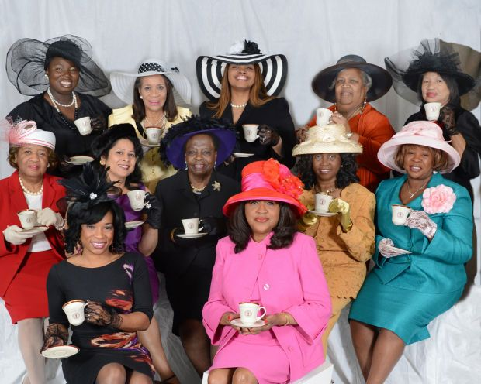
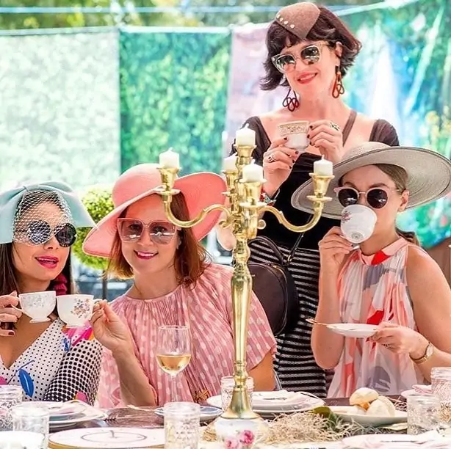
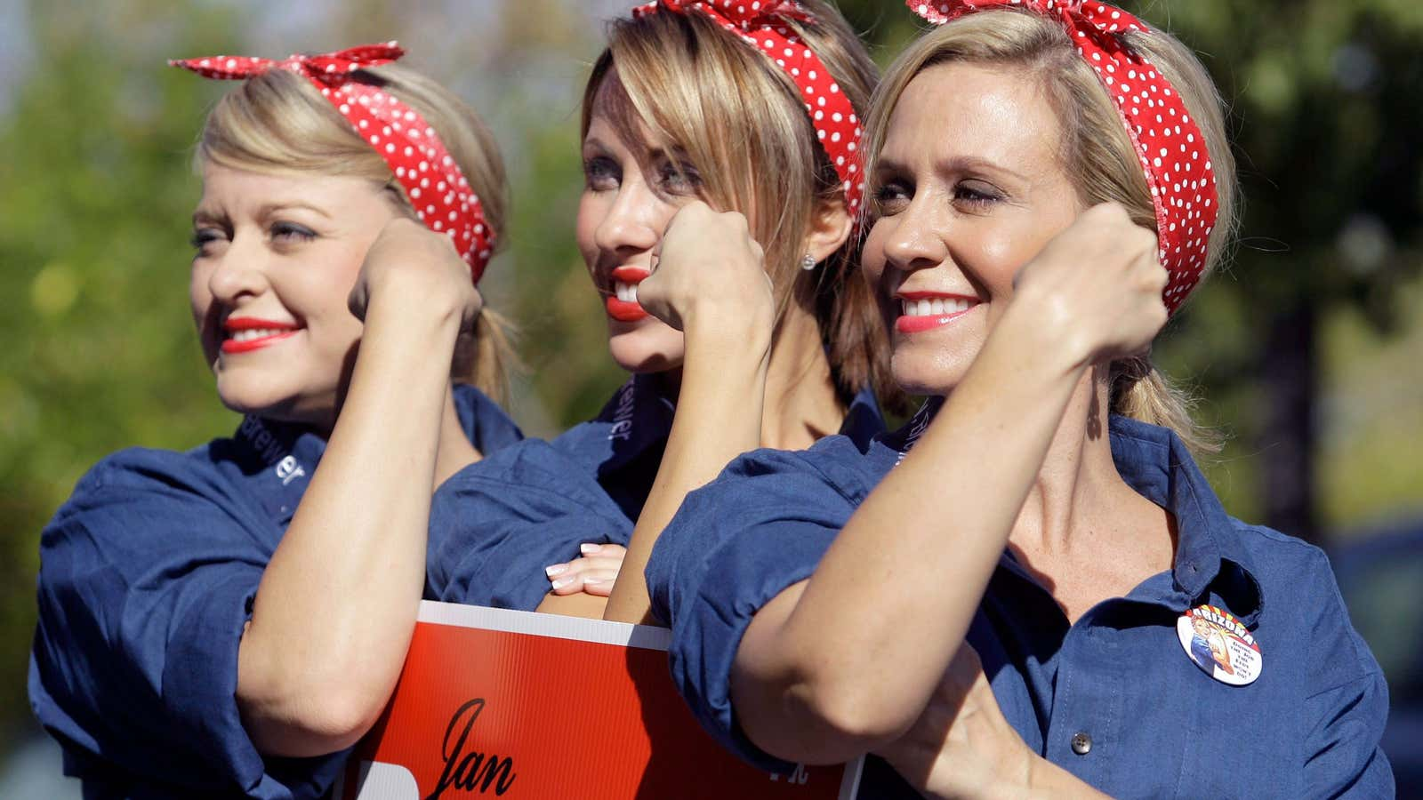
Choose Your Tea Party for Progress
-You do not need to serve tea to others
-Minimum participation: 2 people
-Bring nice tea pot and cup for yourself, chair, tiny table (carry with one hand)
-Bring BPW information
GET NOTICED

Slide 6
Potential Issues
You may require consent from venue.
Certain venues will require insurance.
We are not feeding the public, only drawing attention to ourselves.
We are not carrying or collecting money.
We should have access to a cell phone for emergency purposes.
We should be prepared to answer questions in a polite way.
Costs only involve what you already own. If you need something, ask around first. If you have BPW pins, please wear them.
Any other considerations?

Slide 7
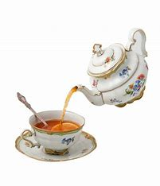
What We Ask
Individually take pictures of your tea party & share #BPWPinkTeaParty25
Host Facebook/Instagram live videos as an individual or a pair where they discuss the event
Write post for about what you’ve gotten out of being a member & share #BPWPinkTeaParty25
Share Ontario’s membership drive posts on social media with your followers
Ask visitors to add their emails to receive our newsletter
What We Will Track
We will ask your club how many people the event attracted
We will ask if anyone collected membership forms and/or emails for the newsletter
We will remain attuned to post engagement differences on our social media and website

Slide 8
What We Will Provide
1. Letter for Management: A BPW-Ontario letter to inform the venues about who we are and the purpose of the event
2. An Introduction Letter for Visitors: A BPW-Ontario document about us and why we are out on April 12th
3. A BPW-Ontario document to collect emails for our newsletter
4. A BPW-Ontario document to sign up for membership
Important Dates
- A list of locations that you have agreements to participate at by March 31st
- To submit all numbers of visitors, email consent form by April 14th

